Slide 1
Acting and Directing w/ Ms. Scott Day 10
Counting
Clapping
The River - Fill the negative Space
How to Apply the Viewpoints
Rehearse Small Composition
Notes:
Count to 20 - if you repeat then you have to start again
Once you are able to move truly in unison with others, you can start to work with more advanced concepts of counterpoint, juxtaposition and contrast.
The River (Did this exercise to music) - Choose two or three people to remain in the center and ask everyone else to step out and observe the shape created by those who are left. (The people you choose to keep in the center should, of course, be in a shape which is strong, clear, dynamic and useful.) Have the outside group look at the center shape together, observe it, point out what is strong about the shape.

Slide 2
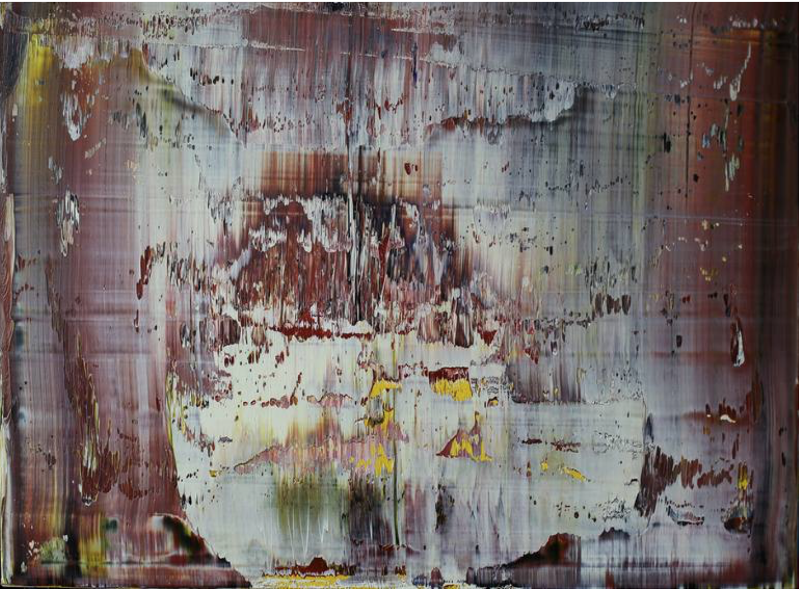
Notes:
What do you see?
Comparing the Viewpoints work to abstract art - This way in came about due to my students being confused by what the Viewpoints work can offer an audience.

Slide 3
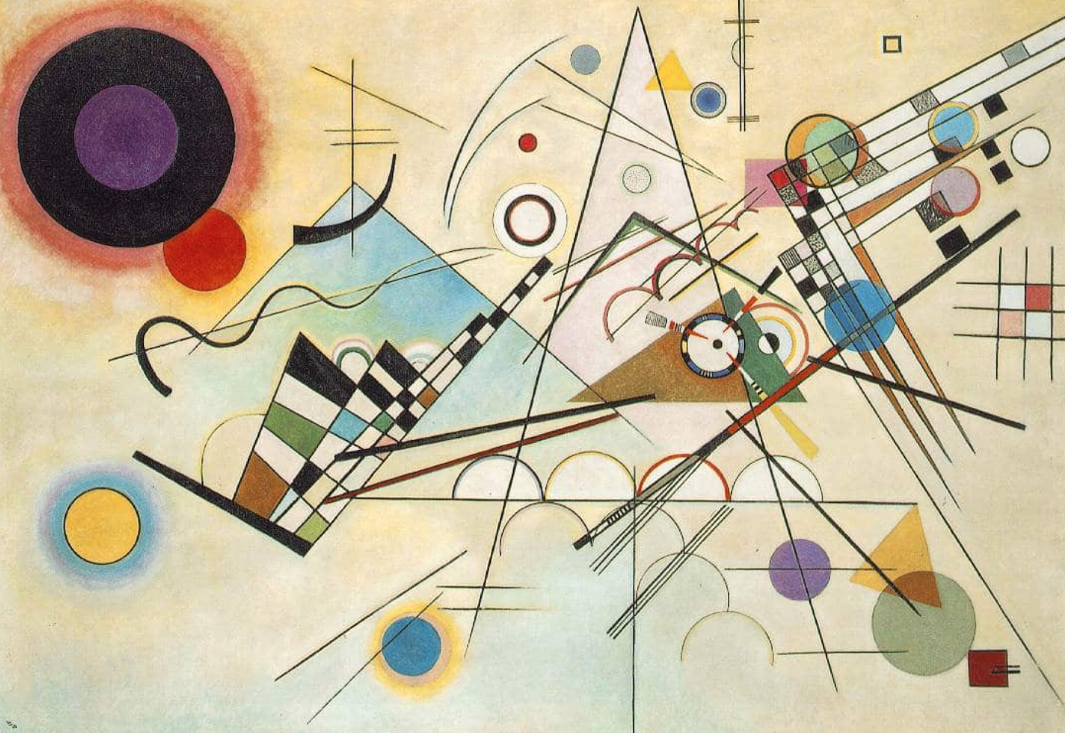
Notes:
What do you see?
After this slide, I showed them a rehearsal exercise my company and I did in London when we were creating or show, “This Might Be It.”
After I showed them the raw rehearsal material, I played the teaser video of “This Might Be It” and pointed out where we inserted the evolved Viewpoints work.
This sparked their interest and clarified what I was asking of them when creating their small composition work.

Slide 4
The 9 Physical Viewpoints
Tempo - How fast or slow can you go?
Duration - How long do you stay inside a movement before it changes?
Kinesthetic Response - Response to something that happens outside of you
Repetition - A moment or movement
Spatial Relationship - How close can you be without touching? How far away can you be and still be relation to one another?
Shape - Lines,curves, or a combination, Stationary or moving through space, Individual, with architecture, or with other bodies
Gesture - Expressive or Behavioral, Public or Private
Architecture - Solid mass, texture, light, color, sound
Topography- The landscape, pattern, or design we make

Slide 5
Acting and Directing w/ Ms. Scott Day 10
Group 1 | Group 2 | Group 3 | Group 4
Elianna | Tito | Eva | Nina
Alex | Gabby | Akhil | Conor
Ambar | Mason | Phillip | Mia
Cory | Grace | Val | Shanae
Bella | Max | Abigail | Jake
Notes:
I know this is abstract and weird and it’s hard to get out of your head, but we’re going to do it and see what happens
I know you want answers, a guarantee and a short cut - Viewpoints provides none of these.

Slide 6
Acting and Directing w/ Ms. Scott Day 10
By the end of class you will…
Collaborate with your peers
Introduce text into your Viewpoints work
Reflect on your process so far
Notes:
There are many ways into the Composition work:
- You can each work with one viewpoint and interact with each other
- You can all make gestures and string them together like last week
- You can play the flow exercise and let it morph into something else
- My ensemble and I worked on a grid topography with a set number of specific gestures - Matt came out to direct us

